Slide 1
Topic 5: Structs, stderr
CAB202 – Microprocessors and Digital Systems
Unit Coordinator: Luis Mejias Alvarez
Lecturer: Lawrence Buckingham

Slide 2
References

Slide 3
Practical C Programming
Chapter 12 – Advanced Types
Chapter 13 – Pointers
Chapter 14 – File Input/Output
Tutorialspoint C - Structures

Slide 4
Structs

Slide 5
What's a struct
A struct is a data object which contains other items.
Compare to array:
list of elements which have the same data type;
identified by position;
accessible via index expression.
Struct is:
list of fields (variables) of any type;
identified by field name.

Slide 6
Syntax of a struct type declaration
struct tag-name { field_definition; field_definition; ... field_definition; };
tag_name is a C identifier.
field_definition is basically the same as a variable declaration with no initial value assignment.

Slide 7
Why struct?
An instance of a struct type:
Contains each of its fields.
When assigned to another instance, the fields are copied from the source into the destination.
So each instance of a struct gets its own copy of the field values.
Watch out for pointers -- a copy of a pointer still points at the original data.

Slide 8
Why struct...
Useful to collect data related to a particular object into a single variable.
Analogy:
Spreadsheet with table.
Each column is like an array (all items in column are the same type; accessed by position
Each row is like a struct (a list of related items of diverse types, acessed by column name)

Slide 9
http://www.bom.gov.au/products/IDQ60801/IDQ60801.94576.shtml
local_date_time[80] | local_date_time_full[80] | aifstime_utc[80] | lat | lon | apparent_t
20/08:00pm | 20190820200000 | 20190820100000 | -27.5 | 153 | 11.8
20/07:30pm | 20190820193000 | 20190820093000 | -27.5 | 153 | 11.8
20/07:00pm | 20190820190000 | 20190820090000 | -27.5 | 153 | 12.5
20/06:30pm | 20190820183000 | 20190820083000 | -27.5 | 153 | 13.5
20/06:00pm | 20190820180000 | 20190820080000 | -27.5 | 153 | 14
20/05:30pm | 20190820173000 | 20190820073000 | -27.5 | 153 | 14.1
20/05:00pm | 20190820170000 | 20190820070000 | -27.5 | 153 | 15.6
20/04:30pm | 20190820163000 | 20190820063000 | -27.5 | 153 | 16.9
20/04:00pm | 20190820160000 | 20190820060000 | -27.5 | 153 | 18.2
20/03:30pm | 20190820153000 | 20190820053000 | -27.5 | 153 | 18.3
20/03:00pm | 20190820150000 | 20190820050000 | -27.5 | 153 | 18.7
20/02:30pm | 20190820143000 | 20190820043000 | -27.5 | 153 | 17.8
20/02:00pm | 20190820140000 | 20190820040000 | -27.5 | 153 | 17.9
20/01:30pm | 20190820133000 | 20190820033000 | -27.5 | 153 | 17.2
20/01:00pm | 20190820130000 | 20190820030000 | -27.5 | 153 | 17.2

Slide 10
Columns are arrays
local_date_time[80] | local_date_time_full[80] | aifstime_utc[80] | lat | lon | apparent_t
20/08:00pm | 20190820200000 | 20190820100000 | -27.5 | 153 | 11.8
20/07:30pm | 20190820193000 | 20190820093000 | -27.5 | 153 | 11.8
20/07:00pm | 20190820190000 | 20190820090000 | -27.5 | 153 | 12.5
20/06:30pm | 20190820183000 | 20190820083000 | -27.5 | 153 | 13.5
20/06:00pm | 20190820180000 | 20190820080000 | -27.5 | 153 | 14
20/05:30pm | 20190820173000 | 20190820073000 | -27.5 | 153 | 14.1
20/05:00pm | 20190820170000 | 20190820070000 | -27.5 | 153 | 15.6
20/04:30pm | 20190820163000 | 20190820063000 | -27.5 | 153 | 16.9
20/04:00pm | 20190820160000 | 20190820060000 | -27.5 | 153 | 18.2
20/03:30pm | 20190820153000 | 20190820053000 | -27.5 | 153 | 18.3
20/03:00pm | 20190820150000 | 20190820050000 | -27.5 | 153 | 18.7
20/02:30pm | 20190820143000 | 20190820043000 | -27.5 | 153 | 17.8
20/02:00pm | 20190820140000 | 20190820040000 | -27.5 | 153 | 17.9
20/01:30pm | 20190820133000 | 20190820033000 | -27.5 | 153 | 17.2
20/01:00pm | 20190820130000 | 20190820030000 | -27.5 | 153 | 17.2

Slide 11
rows are structs
local_date_time[80] | local_date_time_full[80] | aifstime_utc[80] | lat | lon | apparent_t
20/08:00pm | 20190820200000 | 20190820100000 | -27.5 | 153 | 11.8
20/07:30pm | 20190820193000 | 20190820093000 | -27.5 | 153 | 11.8
20/07:00pm | 20190820190000 | 20190820090000 | -27.5 | 153 | 12.5
20/06:30pm | 20190820183000 | 20190820083000 | -27.5 | 153 | 13.5
20/06:00pm | 20190820180000 | 20190820080000 | -27.5 | 153 | 14
20/05:30pm | 20190820173000 | 20190820073000 | -27.5 | 153 | 14.1
20/05:00pm | 20190820170000 | 20190820070000 | -27.5 | 153 | 15.6
20/04:30pm | 20190820163000 | 20190820063000 | -27.5 | 153 | 16.9
20/04:00pm | 20190820160000 | 20190820060000 | -27.5 | 153 | 18.2
20/03:30pm | 20190820153000 | 20190820053000 | -27.5 | 153 | 18.3
20/03:00pm | 20190820150000 | 20190820050000 | -27.5 | 153 | 18.7
20/02:30pm | 20190820143000 | 20190820043000 | -27.5 | 153 | 17.8
20/02:00pm | 20190820140000 | 20190820040000 | -27.5 | 153 | 17.9
20/01:30pm | 20190820133000 | 20190820033000 | -27.5 | 153 | 17.2
20/01:00pm | 20190820130000 | 20190820030000 | -27.5 | 153 | 17.2

Slide 12
Example 1
struct_demo_01.c
Illustrates:
Defining a struct.
Reading data into the fields of a struct.
Returning a struct from a function (by value).
Sending a struct to a function (by value).
Writing the contents of a struct to a stream.
Use of standard error stream (if you uncomment some lines).

Slide 13
Example: point (apology owed for poor formatting )
struct tag
struct point
{
bool ok;
double x;
double y;
};
Fields
Each instance of the new struct will have its own copy of the fields.

Slide 14
read_point function returns an instance of a struct
struct point read_point(FILE *f)
{
struct point result = {false, 0, 0};
int num = fscanf(f, "%lf %lf", &result.x, &result.y);
result.ok = (num == 2) && (result.x >= 0) &&
(result.x <= 1) && (result.y >= 0) && (result.y <= 1);
return result;
}
Return type

Slide 15
read_point function declares and initialises a local instance of struct
struct point read_point(FILE *f)
{
struct point result = {false, 0, 0};
int num = fscanf(f, "%lf %lf", &result.x, &result.y);
result.ok = (num == 2) && (result.x >= 0) &&
(result.x <= 1) && (result.y >= 0) && (result.y <= 1);
return result;
}
Variable called result, type is struct point, initial values for fields assigned in order of declaration.

Slide 16
Use the . operator to dereference the fields of a struct
struct point read_point(FILE *f)
{
struct point result = {false, 0, 0};
int num = fscanf(f, "%lf %lf", &result.x, &result.y);
result.ok = (num == 2) && (result.x >= 0) &&
(result.x <= 1) && (result.y >= 0) && (result.y <= 1);
return result;
}
Gets the address of field x from variable called result.

Slide 17
Use the . operator to dereference the fields of a struct
struct point read_point(FILE *f)
{
struct point result = {false, 0, 0};
int num = fscanf(f, "%lf %lf", &result.x, &result.y);
result.ok = (num == 2) && (result.x >= 0) &&
(result.x <= 1) && (result.y >= 0) && (result.y <= 1);
return result;
}
Get the value of field x from variable called result.

Slide 18
Use the . operator to dereference the fields of a struct
struct point read_point(FILE *f)
{
struct point result = {false, 0, 0};
int num = fscanf(f, "%lf %lf", &result.x, &result.y);
result.ok = (num == 2) && (result.x >= 0) &&
(result.x <= 1) && (result.y >= 0) && (result.y <= 1);
return result;
}
Assign new value to field ok of result.

Slide 19
Use the . operator to dereference the fields of a struct
struct point read_point(FILE *f)
{
struct point result = {false, 0, 0};
int num = fscanf(f, "%lf %lf", &result.x, &result.y);
result.ok = (num == 2) && (result.x >= 0) &&
(result.x <= 1) && (result.y >= 0) && (result.y <= 1);
return result;
}
Send a copy of result back to caller via return.

Slide 20
write_point sends contents of a struct to a stream
void write_point(FILE *f, struct point p)
{
fprintf(f, "%s: %f %f",
(p.ok ? "valid" : "invalid"),
p.x,
p.y
);
}
Parameter of p is an instance of struct point. Contains a copy of data sent to the function for writing.

Slide 21
write_point (2 of 4)
void write_point(FILE *f, struct point p)
{
fprintf(f, "%s: %f %f",
(p.ok ? "valid" : "invalid"),
p.x,
p.y
);
}
If field ok of p is true, send the word "valid" to stream; otherwise send the word "invalid".

Slide 22
write_point (3 of 4)
void write_point(FILE *f, struct point p)
{
fprintf(f, "%s: %f %f",
(p.ok ? "valid" : "invalid"),
p.x,
p.y
);
}
Send contents of field x of p to stream.

Slide 23
write_point (4 of 4)
void write_point(FILE *f, struct point p)
{
fprintf(f, "%s: %f %f",
(p.ok ? "valid" : "invalid"),
p.x,
p.y
);
}
Send contents of field y of p to stream.

Slide 24
Driver program - plots a list of points on the terminal
int main(int argc, char *argv[])
{
if (argc > 1)
{ // Process file.
...
}
else
{ // No file name supplied.
...
}
}
argc is the number of command line arguments supplied. It will be greater than 1 if an argument was supplied.

Slide 25
Process file:
FILE *f = fopen(argv[1], "r");
if (f)
{ // Draw contents of file.
...
}
else
{ // Error opening file.
...
}
Try to open the stream named by the first command line argument. The stream is accessed via local variable f.

Slide 26
Process file:
FILE *f = fopen(argv[1], "r");
if (f)
{ // Draw contents of file.
...
}
else
{ // Error opening file.
...
}
If f is not zero, we have successfully opened the stream. Now process the contents.

Slide 27
Draw contents of file:
setup_screen();
while (!feof(f))
{ // Scan points from file and draw.
struct point p = read_point(f);
#if DB
fprintf(stderr, "Point p = ");
write_point(stderr, p);
fprintf(stderr, "\n");
#endif
draw_point(p, '*');
}
fclose(f);
show_screen();
wait_char();
return 0;
Process everything in stream connected to f, i.e. read to end of input.

Slide 28
Draw contents of file:
setup_screen();
while (!feof(f))
{ // Scan points from file and draw.
struct point p = read_point(f);
#if DB
fprintf(stderr, "Point p = ");
write_point(stderr, p);
fprintf(stderr, "\n");
#endif
draw_point(p, '*');
}
fclose(f);
show_screen();
wait_char();
return 0;
Read a point from f, and stash it in a local variable called p, which is an instance of struct point.

Slide 29
Draw contents of file:
setup_screen();
while (!feof(f))
{ // Scan points from file and draw.
struct point p = read_point(f);
#if DB
fprintf(stderr, "Point p = ");
write_point(stderr, p);
fprintf(stderr, "\n");
#endif
draw_point(p, '*');
}
fclose(f);
show_screen();
wait_char();
return 0;
If we want to, we can send debugging information to the standard error stream via fprintf. This is controlled by a preprocessor constant called DB.

Slide 30
Draw contents of file:
setup_screen();
while (!feof(f))
{ // Scan points from file and draw.
struct point p = read_point(f);
#if DB
fprintf(stderr, "Point p = ");
write_point(stderr, p);
fprintf(stderr, "\n");
#endif
draw_point(p, '*');
}
fclose(f);
show_screen();
wait_char();
return 0;
Draw the point.

Slide 31
We examine the code in VSCode, and run the program.
To use the debugging code:
#define DB 1 instead of 0
use command line output redirection to send the standard error text from the program into a file.
./prog arg1 arg2 2>somefile.txt
You can even open a new terminal and send the debug output there
Use the tty command in the new terminal to get its stream name, e.g. /dev/pty1
./prog arg1 arg2 2>/dev/pty1

Slide 32
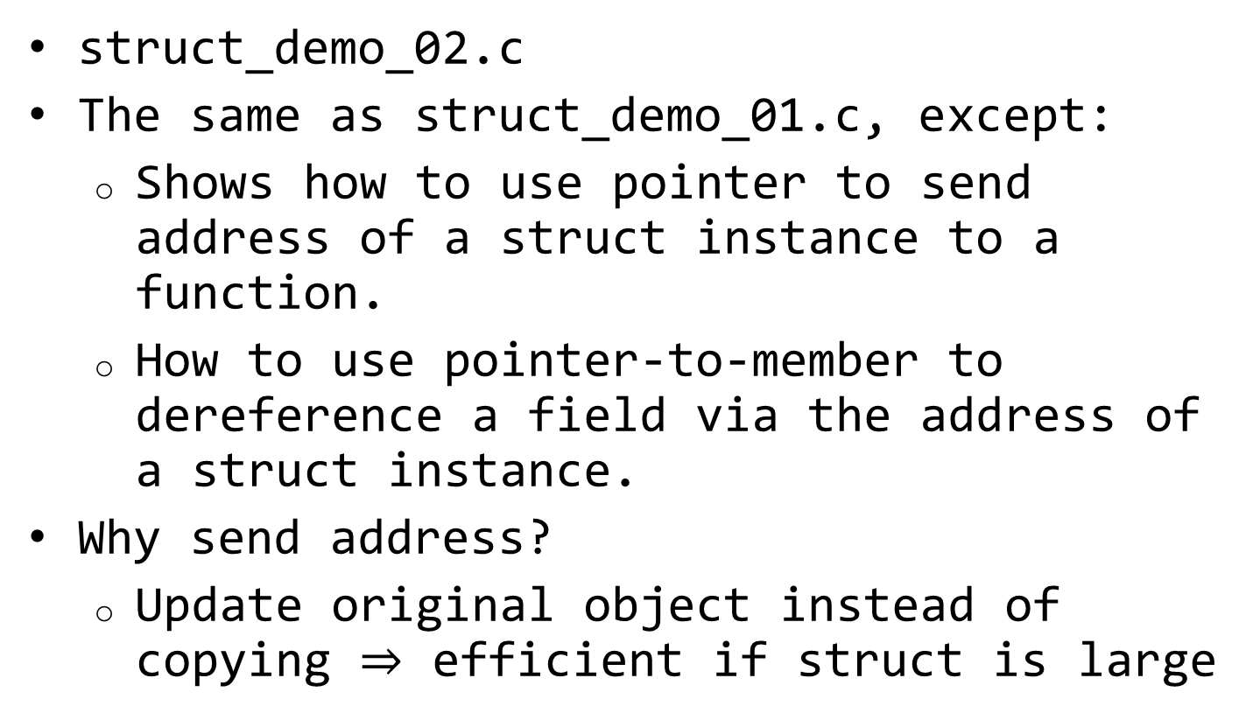
Example 2
struct_demo_02.c
The same as struct_demo_01.c, except:
Shows how to use pointer to send address of a struct instance to a function.
How to use pointer-to-member to dereference a field via the address of a struct instance.
Why send address?
Update original object instead of copying $⇒$ efficient if struct is large

Slide 33
read_point with pointer to struct
void read_point(FILE *f, struct point * p)
{
int fields_scanned = fscanf(f, "%lf %lf", &p->x, &p->y);
p->ok = (fields_scanned == 2) && (p->x >= 0) &&
(p->x <= 1) && (p->y >= 0) && (p->y <= 1);
}
Formal parameter p is the address of an instance of struct point.

Slide 34
read_point with pointer to struct
void read_point(FILE *f, struct point * p)
{
int fields_scanned = fscanf(f, "%lf %lf", &p->x, &p->y);
p->ok = (fields_scanned == 2) && (p->x >= 0) &&
(p->x <= 1) && (p->y >= 0) && (p->y <= 1);
}
Return type is void -- instead of return, we use the pointer to reach back and drop the data directly into a variable declared in the calling scope.

Slide 35
read_point with pointer to struct
void read_point(FILE *f, struct point * p)
{
int fields_scanned = fscanf(f, "%lf %lf", &p->x, &p->y);
p->ok = (fields_scanned == 2) && (p->x >= 0) &&
(p->x <= 1) && (p->y >= 0) && (p->y <= 1);
}
Reads a floating point value into field x of the object pointed at by p. p->x is identical in meaning to (*p).x

Slide 36
write_point with pointer tp struct
void write_point(FILE *f, struct point *p)
{
fprintf(f, "%s: %f %f",
(p->ok ? "valid" : "invalid"), p->x, p->y);
}
p.x becomes p->x, p.ok becomes p->ok, p.y becomes p->y

Slide 37
Back in main
while (!feof(f))
{ // Scan points from file and draw.
struct point p;
read_point(f, &p);
draw_point(&p, '*');
}
An instance of struct point is declared but not initialised. Space is allocated, waiting for data to be inserted.

Slide 38
Back in main
while (!feof(f))
{ // Scan points from file and draw.
struct point p;
read_point(f, &p);
draw_point(&p, '*');
}
Send the address of the object to read_point to be populated with data from the stream.

Slide 39
Back in main
while (!feof(f))
{ // Scan points from file and draw.
struct point p;
read_point(f, &p);
draw_point(&p, '*');
}
Send the address of the object to draw_point to be rendered onto the terminal.

Slide 40

Array of struct
Array $⇒$ column in table
Struct $⇒$ row of table
Array of struct $⇒$ table

Slide 41
main: variation 3 with an array of points
struct point p[MAX] = {{false, 0, 0}};
int n;
for (n = 0; n < MAX && !feof(f); n++)
{ // Scan points from file.
read_point(f, &p[n]);
}
fclose(f);
setup_screen();
draw_points(p, n);
show_screen();
wait_char();
return 0;

Slide 42
main: variation 3 with an array of points
struct point p[MAX] = {{false, 0, 0}};
int n;
for (n = 0; n < MAX && !feof(f); n++)
{ // Scan points from file.
read_point(f, &p[n]);
}
fclose(f);
setup_screen();
draw_points(p, n);
show_screen();
wait_char();
return 0;
Array called p, with capacity for MAX elements, each of which is an instance of struct point. first element is initialised, remainder is zero filled automatically.

Slide 43
main: variation 3 with an array of points
struct point p[MAX] = {{false, 0, 0}};
int n;
for (n = 0; n < MAX && !feof(f); n++)
{ // Scan points from file.
read_point(f, &p[n]);
}
fclose(f);
setup_screen();
draw_points(p, n);
show_screen();
wait_char();
return 0;
When using array, always need a counter to tell us how many useful elements there are.

Slide 44
main: variation 3 with an array of points
struct point p[MAX] = {{false, 0, 0}};
int n;
for (n = 0; n < MAX && !feof(f); n++)
{ // Scan points from file.
read_point(f, &p[n]);
}
fclose(f);
setup_screen();
draw_points(p, n);
show_screen();
wait_char();
return 0;
Read up to MAX points, or until EOF, whichever comes first. Either way, when loop finishes, n will have number of elements.

Slide 45
main: variation 3 with an array of points
struct point p[MAX] = {{false, 0, 0}};
int n;
for (n = 0; n < MAX && !feof(f); n++)
{ // Scan points from file.
read_point(f, &p[n]);
}
fclose(f);
setup_screen();
draw_points(p, n);
show_screen();
wait_char();
return 0;
Read one point, into p[n].

Slide 46
main: variation 3 with an array of points
struct point p[MAX] = {{false, 0, 0}};
int n;
for (n = 0; n < MAX && !feof(f); n++)
{ // Scan points from file.
read_point(f, &p[n]);
}
fclose(f);
setup_screen();
draw_points(p, n);
show_screen();
wait_char();
return 0;
Display all the points.

Slide 47
draw_points: draws a list of points
void draw_points(struct point p[], int n)
{
for (int i = 0; i < n; i++)
{
draw_point(&p[i], '*');
}
}3
p is an array of points.

Slide 48
draw_points: draws a list of points
void draw_points(struct point p[], int n)
{
for (int i = 0; i < n; i++)
{
draw_point(&p[i], '*');
}
}3
Send the address of element i of array p to draw_point.

Slide 49
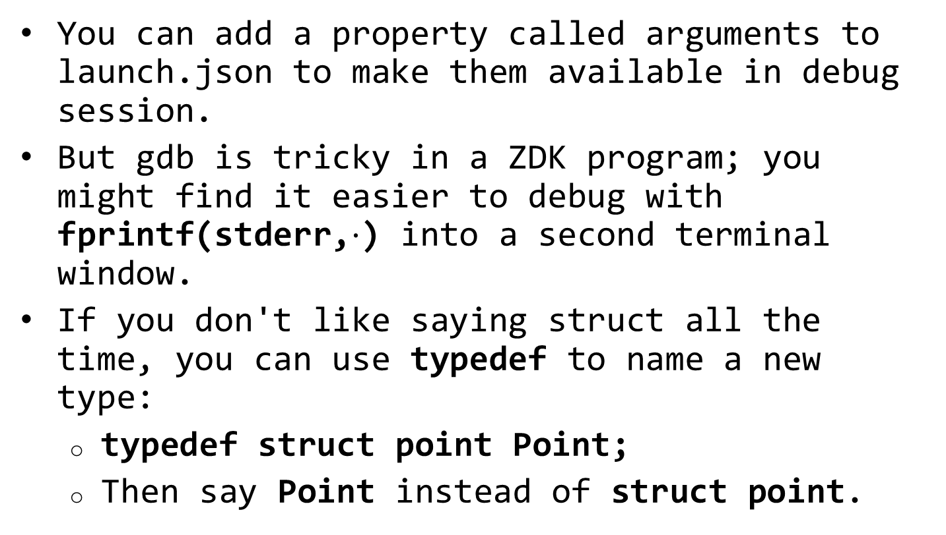
Random
You can add a property called arguments to launch.json to make them available in debug session.
But gdb is tricky in a ZDK program; you might find it easier to debug with fprintf(stderr,$⋅$) into a second terminal window.
If you don't like saying struct all the time, you can use typedef to name a new type:
typedef struct point Point;
Then say Point instead of struct point.

